Slide 1
SQL INJECTION
LAB – 8

Slide 2
INTRODUCTION TO SQL INJECTION
A SQL INJECTION attack consists of insertion or “injection” of a SQL query via the input data from the client to the application.
This allows the attacker the access to data of other users and all kinds of data that the application can access.
We realise that a system is prone to this type of attack when there is an error when the system returns a vulnerability when performing the login action.
After realizing the vulnerability of the system, we will try to bypass using different types of Injection.
Different types of injections are provided here: xmendez/wfuzz: Web application fuzzer (github.com)
The need for SQL injection is that it provides us with a kind of penetration testing so that we can make a system that is vulnerable with such kinds of attacks.

Slide 3
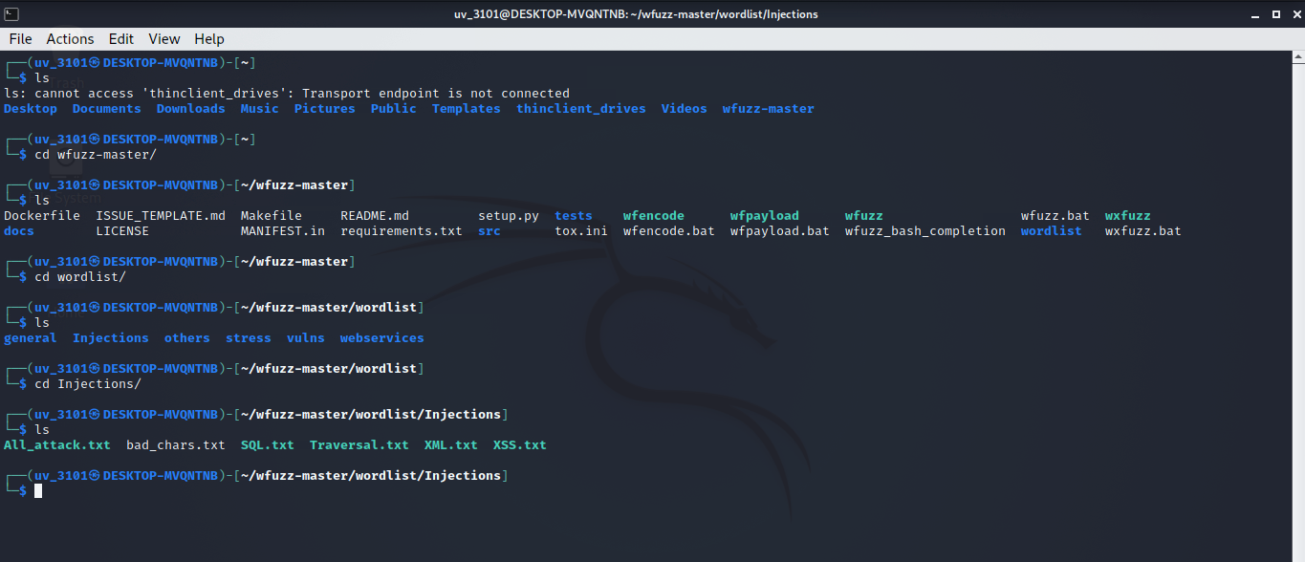
Example
After cloning the repository that is provided in the previous slide and going into the wordlist directory, we can see different directories like show in the screenshot.
And if we open the SQL.txt file, in it we can see different injection attacks and different vulnerabilities we can cause by inputting the password in a different way.

Slide 4
STEPS TO PEFORM SQL INJECTION
LINK PROVIDED IN THE DOCUMENT: SQL Injection
In the link we can perform SQL injection attack on a bank system.
Email: user@gmail.com
Password: password
After that we get to know that we failed to guess the password of the user.
So, now we try to find some way to perform SQL injection attack. To find out if a system is vulnerable to an Injection attack, we try to find its vulnerability using any type of injection present in the SQL.txt file from the previous slide.
First, lets provide the username and password of the user whose bank account we want to access:

Slide 5
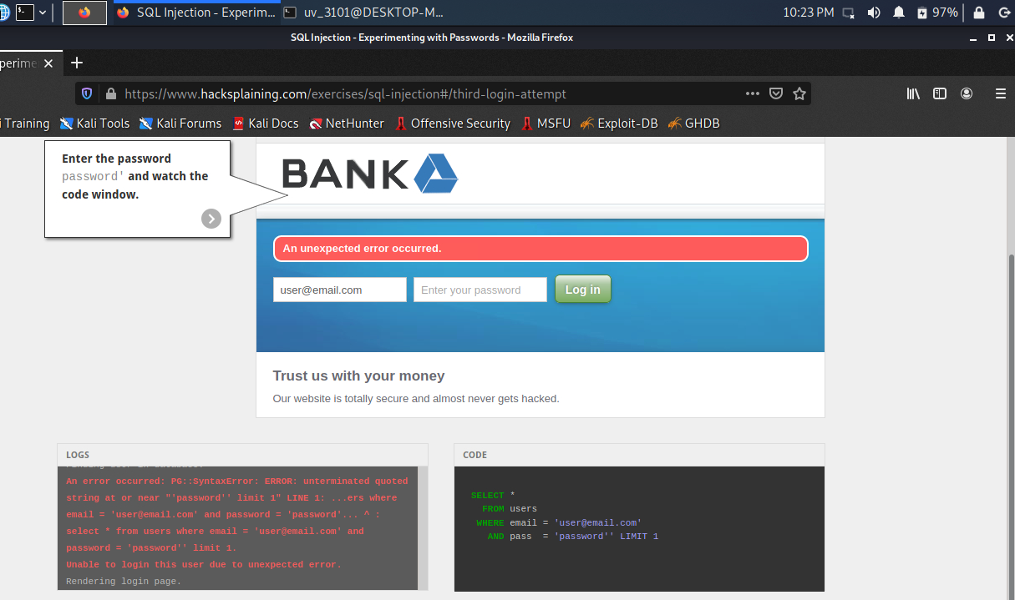
STEPS
In this lab, we choose the easiest of the injection attack which is adding ‘ in the end of the password we are guessing.
In the log window we can see that there has been a vulnerability. Now, we will try to exploit this vulnerability.
We can exploit this vulnerability by using SQL type syntax where the password field always returns a true value by which it will be easy to login into the system.

Slide 6
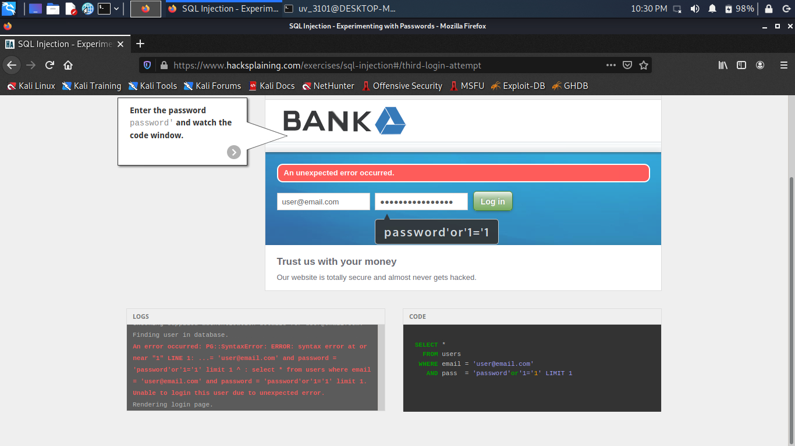
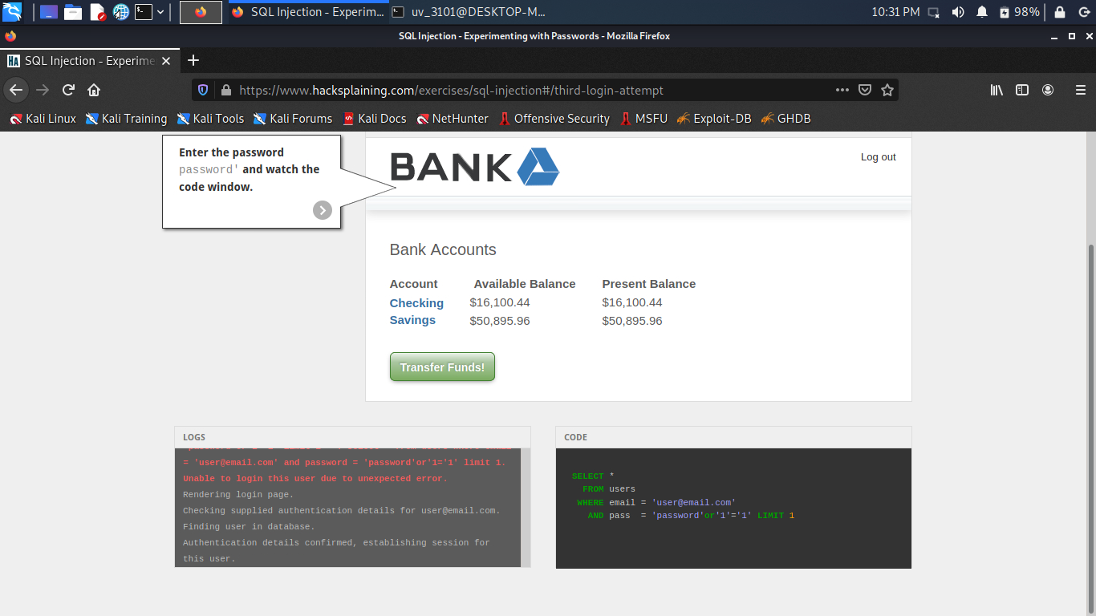
CONCLUSION
After exploiting this vulnerability, we will login into the system as you can see in the next picture.
This is the easiest vulnerability injection into the system. There are many ways to perform the same action of login by using different SQL injection as specified in the SQL.txt file.

